Slide 1


Financial Choices: Your Journey to Success!
Christopher T. Sneed, PhD Associate Professor and Consumer Economics Specialist

Slide 2
DISCLAIMER:
Today’s presentation is education, not legal or financial advice. If professional assistance is required, the services of a competent professional should be sought.

Slide 3
Let’s Chat!

Slide 4
I don’t have a monthly budget, because…..
23%
19%
It’s Not Worth My Time
I’ve Tried, and It Doesn’t Work
18%
17%
I Don’t Have Time
I Spend All of My Money

Slide 5

Why Money Management?
Avoid Debt
1.16 Trillion = American Credit Card Debt (2024)
$5,727 average balance on credit cards in Tennessee
Source: Lending Tree – 2025 Credit Card Debt Statistics

Slide 6
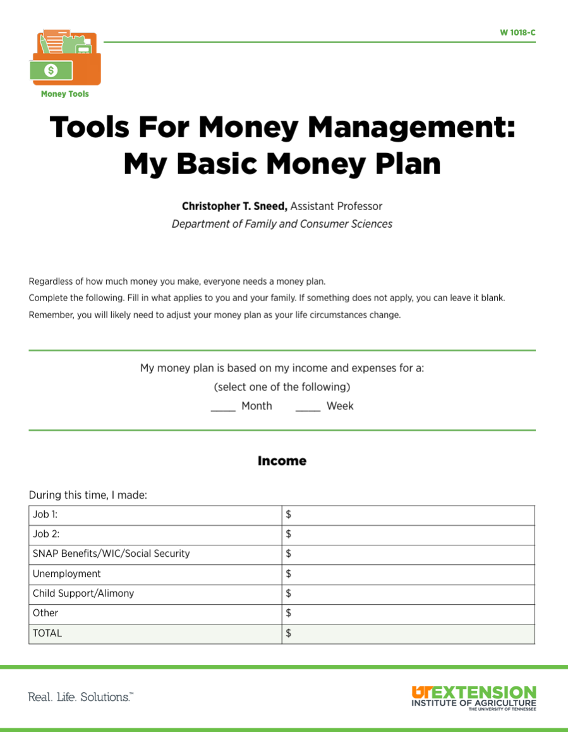
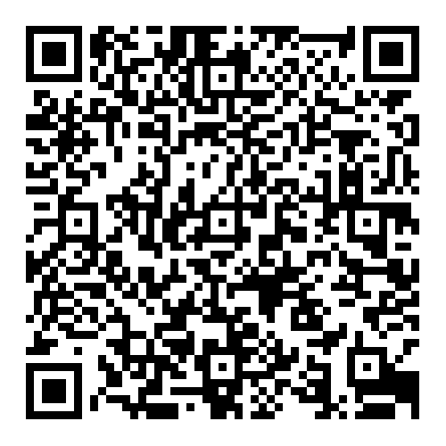
Savings - Spending Plan Worksheet
https://utia.tennessee.edu/publications/wp-content/uploads/sites/269/2023/10/W1018C.pdf

Slide 7

How Much Money Comes in Each Month?
Gross Income: Total you actually earned.
Net Income: Take Home Pay (What is left over after deductions are taken out)

Slide 8
Tracking Your Money
Keep and organize the following items to determine expenses:
Receipts
Bills & Invoices
Credit Card Statement
Bank Statements
Check Registers
Check Stubs and Canceled Checks
Calendar

Slide 9
Tracking Our Money….
Periodic Expenses | Fixed Expenses | Controllable Expenses
Expenses that may not occur every month or are unexpected | Expenses that are the same each month | Expenses that vary each month, but can be controlled and/or adjusted
Medical Bills School Supplies Taxes Car Repair Holiday Spending | Car Payment Child Support Mortgage/Rent | Grocery Bill Utilities Savings Household Expenses Clothing Purchases Travel

Slide 10
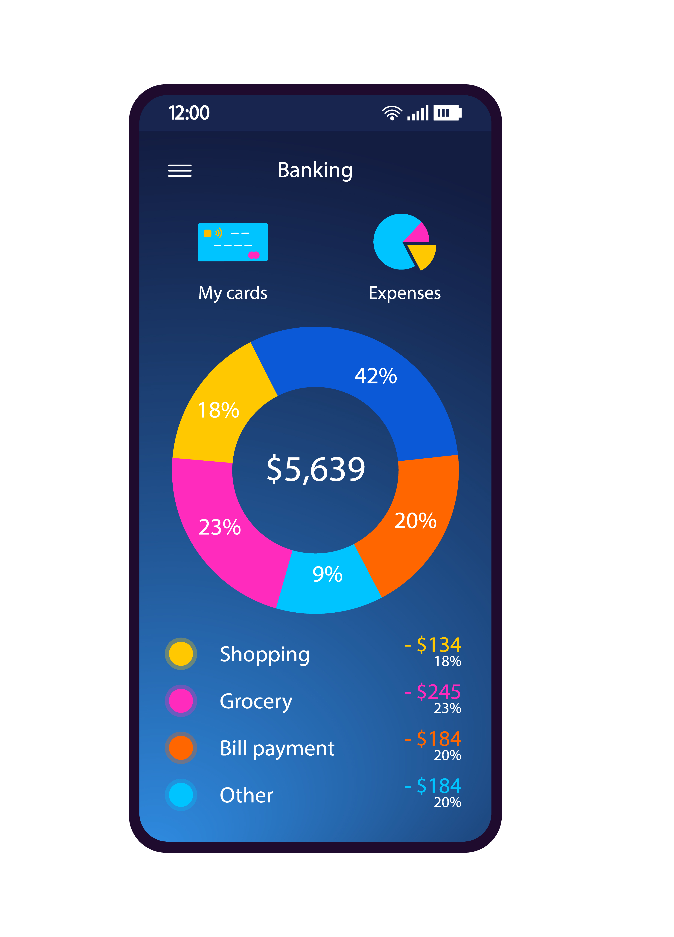
Tools to Track Expenses:
Online Tools/Apps
Jot It Down Method
Bank Statements
Receipt Method: Bag or Envelope
Diary/Journal
Pocket Notebooks
Check Registers

Slide 11
Tools to Track Expenses: Online/Apps
Technology can help in tracking expenses.
When using apps that access checking, savings or credit accounts, be aware of the security risks and protections offered.
Apps may change policies or be sold to other companies. Keep up with their terms of service.
Examples:
Mint: https://www.mint.com
PowerPay: https://powerpay.org/
Building Wealth: https://www.dallasfed.org/~/media/microsites/cd/wealth/consumers.html

Slide 12
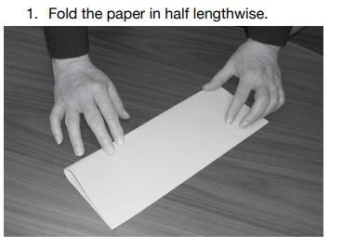
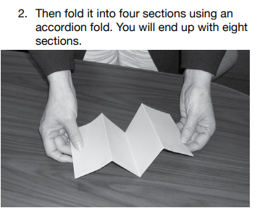
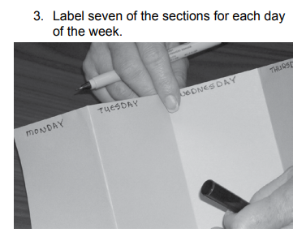
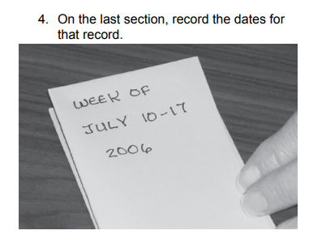

Tools to Track Expenses: Jot It Down
Make a simple weekly spending record from an 8 ½” X 11” piece of paper.

Slide 13

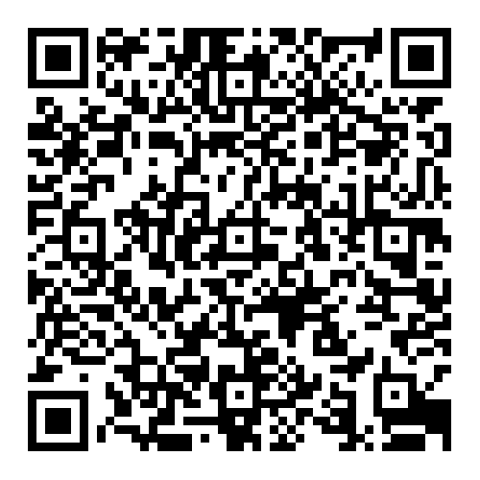
https://utia.tennessee.edu/publications/wp-content/uploads/sites/269/2023/10/W1018A.pdf

Slide 14

Next Step: Compare & Adjust
Compare income and expenses.
Make adjustments as necessary.

Slide 15
$3,600 per month
Expenses | % of Income | Total Spent:
Withholdings | 20.00% | $720.00
Savings | 10.00% | $360.00
Housing | 27.38% | $985.68
Transportation | 18.19% | $523.87
Food | 12.07% | $422.00
Personal Care | 5.58% | $160.70
Health Care & Insurance | 9.00% | $259.20
Clothing | 4.18% | $120.00
Entertainment | 4.15% | $119.00
Donations | 3.5% | $101.00
Other Insurances (Life, etc.) | 1.06% | $28.00
Alcohol & Tobacco | 1.55% | $45.00
Miscellaneous | 3.6% | $106.20
 | ($350.65) | Total: $3,950.65

Slide 16
Trimming Expenses by Plugging Spending Leaks
Find areas where there are spending leaks.
Minor purchases can add up over time.
Choose strategies to plug spending leaks by trimming expenses.

Slide 17
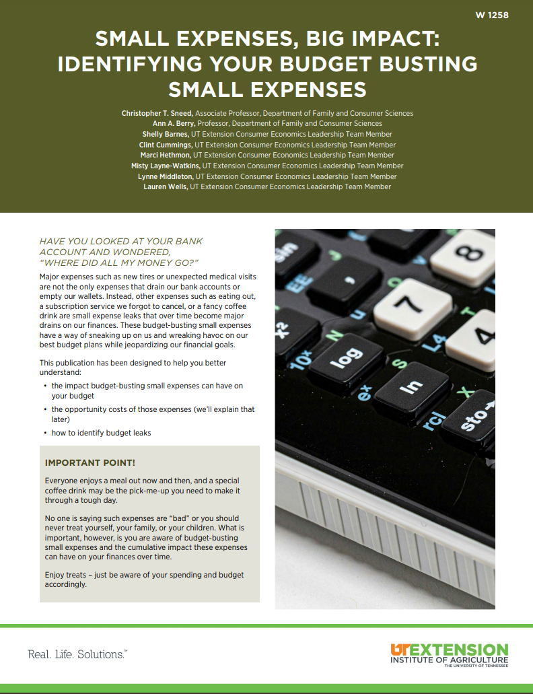
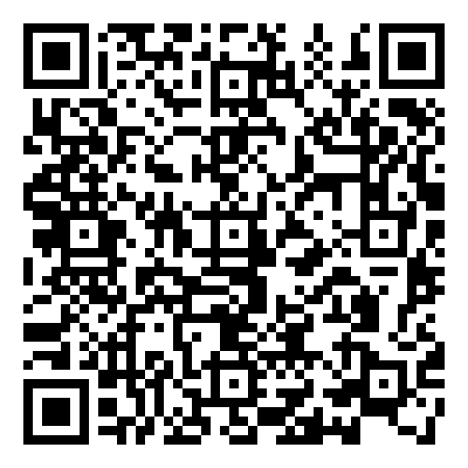
https://utia.tennessee.edu/publications/wp-content/uploads/sites/269/2024/07/W1258.pdf

Slide 18
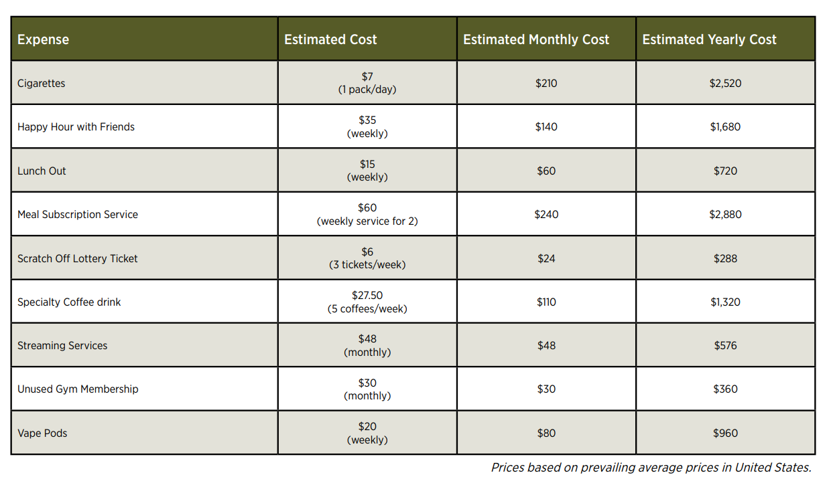

Slide 19
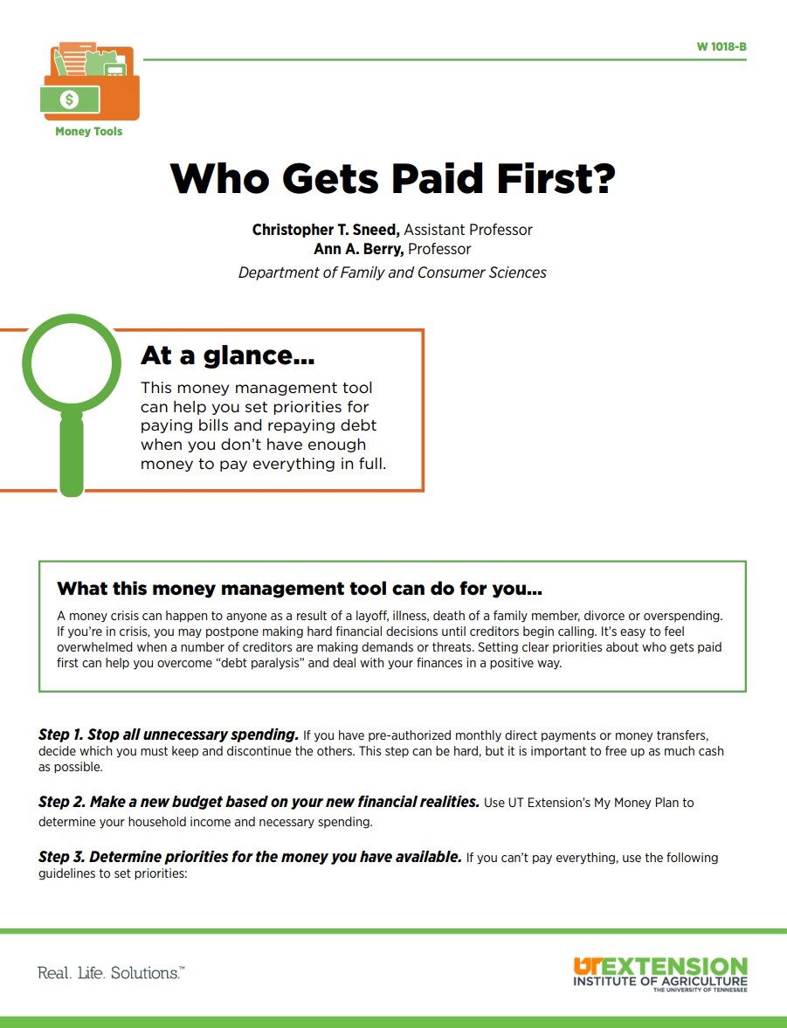
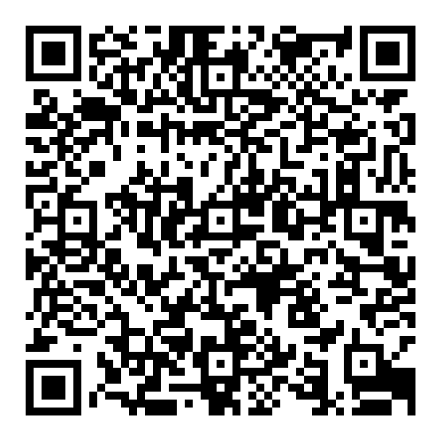
Who Gets Paid First?
https://utia.tennessee.edu/publications/wp-content/uploads/sites/269/2023/10/W1018B.pdf

Slide 20
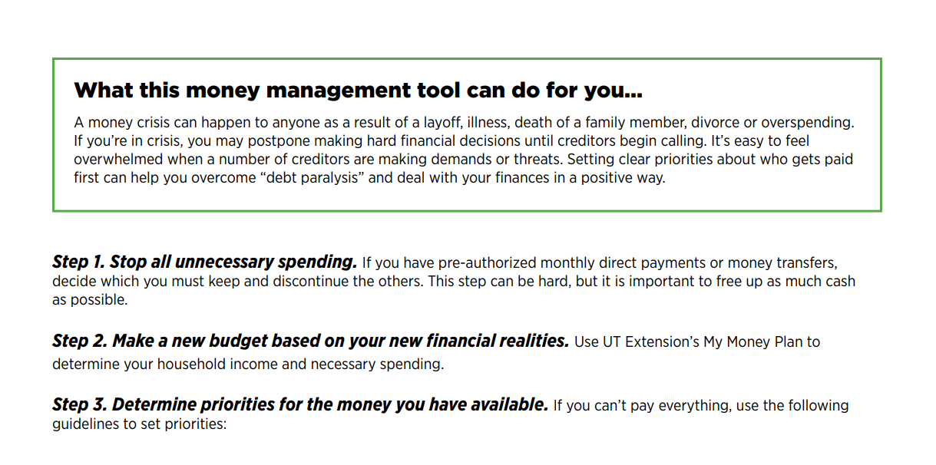
Who Gets Paid First?

Slide 21
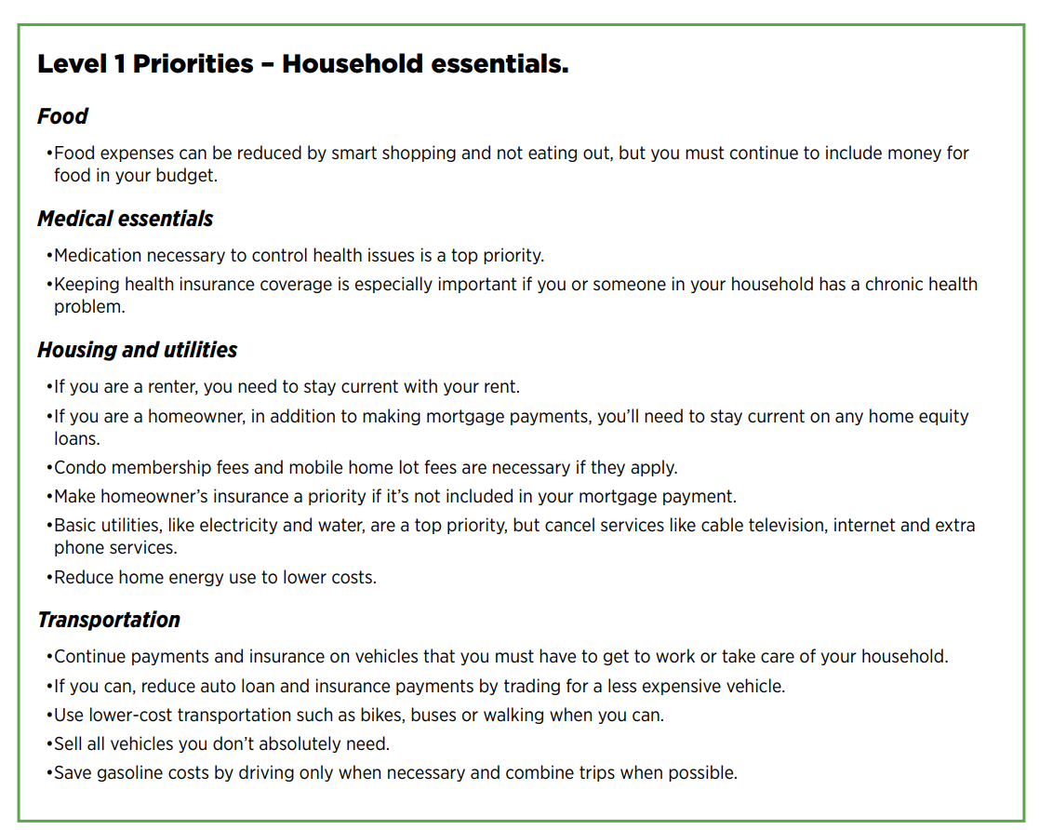

Slide 22
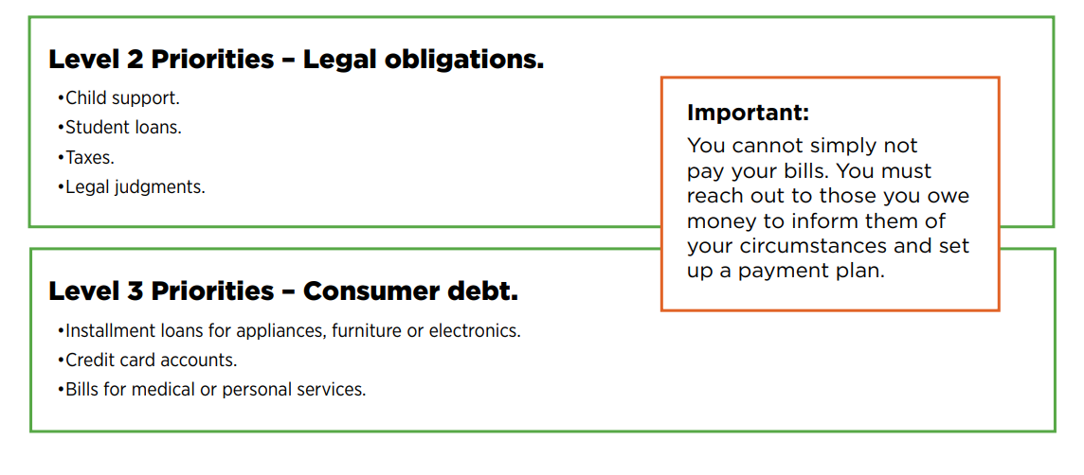

Slide 23

Trimming Expenses: Eat Out Less Often
$3,693 average expense on eating out per year (2023)
Go out to Lunch Every Workday? $2,500 per year ($10.00 per meal)
Source: Bureau of Labor and Statistics

Slide 24

Meal Planning
Create a weekly calendar.
Create grocery list or shop online to stay within budget.
Help plan for the week to avoid eating out.
Stick to what’s on the menu.
Source: https://www.choosemyplate.gov/

Slide 25

Trimming Expenses: Resale Shops/Garage Sales
16% to 18% thrift
Appx. 25,000 thrift/ consignment/ resale shops in US
Millennials thrift most
Source: NARTS: The Association of Resale Professionals

Slide 26

Trimming Expenses: Use the Public Library

Slide 27

Trimming Expenses: Coupons/Savings
Small savings add up.
Take advantage of dealer coupon specials.
Join free store savings programs.

Slide 28
Saving Your Money
2 Types of Savings Accounts
Set Aside Account:
Provides a safe place to set money aside for future use
Earns interest
Nest Egg Account:
Helps you reach specific goals such as buying a house or taking a vacation
Emergency fund is money earmarked for an emergency. Start out by putting aside $50.00 a month for emergency fund.

Slide 29

Pay Yourself First
Start the savings habit now!
Start small and build up the amount
$20 per week X 52 weeks = $1,040 in savings!
$1,040 a year X 5 years = $5,200 in savings (plus interest!)
$100 per month X 12 months = $1,200 in savings!
$1,200 a year X 5 years = $6,000 in savings (plus interest!)

Slide 30

Adapted for state-wide us by Christopher T. Sneed, PhD from “Personal Finance Choices”, Laura Robertson and Priscilla Eddins, UT Extension – Shelby County. 2019.

