Slide 1

CREDIT and BORROWING
Use – Don’t Abuse
1234 5678 9012 3456 7890 1234 5678 9012 3456 7890 1234 5678 9012 3456 7890 1234 5678 9012 3456 7890 1234 5678 9012 3456 7890 1234 5678 9012 3456 7890 1234 5678 9012 3456 7890 1234 5678 9012 3456 7890 1234 5678 9012 3456 7890 1234 5678 9012 3456 7890 1234 5678 9012 3456 7890 1234 5678 9012 3456 7890 1234 5678 9012 3456 7890 1234 5678 9012 3456 7890 1234 5678 9012 3456 7890 1234 5678 9012 3456 7890 1234 5678 9012 3456 7890 1234 5678 9012 3456 7890 1234 5678 9012 3456 7890 1234 5678 9012 3456

Slide 2
WHAT IS CREDIT?
Borrowing money in exchange for your promise to pay it back, usually with interest.

Slide 3


WHAT DO YOU THINK?
Are these good reasons to borrow money?
Taking out a $5,000 student loan for college tuition
Getting a loan to pay your credit card bills
Charging repairs to get your car running again
Charging dinner and movie tickets during a night out with your friends
Buying a laptop that’s on sale using the store’s financing program

Slide 4

TYPES OF CREDIT
Revolving credit
(example: Credit Card)
Installment credit
(example: Car Loan)
Borrow for multiple purchases without going over credit limit
Repay what is owed each month
Borrow a specific amount of money to buy something now
Make regular payments to repay over time by a set date

Slide 5
Types of Credit
Cash Loans
Service Credit
(example: Cellphone, Electricity)
Borrow a specific amount of cash to repay later by a set date
Promise to pay for services used each month

Slide 6
THE LANGUAGE OF CREDIT
Buying on Credit
Making a purchase now and promising to repay later
Principal $
the cost of the item bought on credit
or the amount of money borrowed
Interest %
What the lender charges for using credit
usually a percentage of the principal

Slide 7
ADDING IT UP
Jesse’s brother had a flat tire on his car, but he didn’t have the money on hand to buy a new tire that day.
He was able to purchase a new tire by arranging to repay the $150 owed (principal) for the tire plus 22 percent (interest) in 90 days.
Will Jesse pay more or less than $150 for the tire?
How could Jesse have avoided paying
more than the cost of the tire?

Slide 8
SIMPLE INTEREST
I = P x R x T
Interest
(In Dollars)
=
Principle
(In Dollars)
X
Interest
(In Dollars)
X
Time
(No of Years)
$8.25
=
$150
X
.22
X
3/12
Solving for I (Interest)

Slide 9
MORE TERMS TO KNOW
Annual Percentage Rate (APR)%
Consistent way to report interest;
includes interest rate, fees, and loan costs
Maturity Date
When the final payment is due for a loan
Grace Period
The amount of time before interest
starts accumulating on charged purchases
if payment is not received

Slide 10
The Five C’s of Credit
Capital
Capacity
Character
Collateral
Conditions

Slide 11
TYPICALLY FOUND ON A
CREDIT APPLICATION
Full, legal name
Current address and phone number
Date of birth and Social Security number
Current employer
Monthly income
Bank name and account number
Monthly rent or mortgage payment

Slide 12
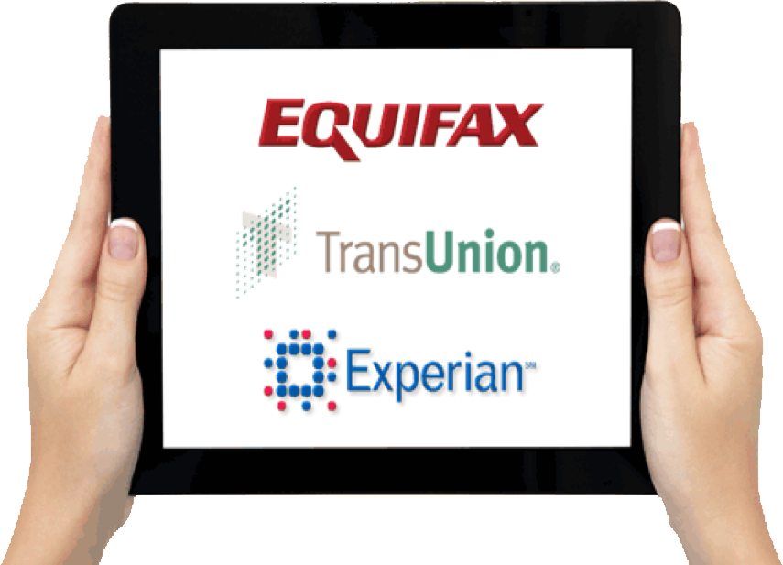
CREDIT REPORTS AND AGENCIES

Slide 13
WHAT’S INCLUDED ON
CREDIT REPORT
Personal Information
Payment Records
Public Records
Inquiries

Slide 14

HOW LONG IT LASTS
Public Records – 7 Years
Account Information – 7 Years
Inquiries – 2 Years
Bankruptcy – 7 to 10 Years

Slide 15
CREDIT SCORING
Statistical model or formula
Compares applicants to experience
Defines credit risk by rank
Assumes future resembles past

Slide 16
YOUR CREDIT SCORE
Source: myFICO.com

Slide 17
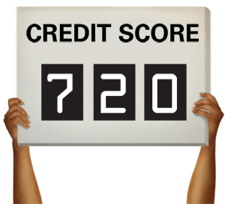
SCORE IS IMPORTANT
Determines:
Loan approval
Interest rates
Other fees
Servicing rules
Down payment

Slide 18
CREDIT SCORES
  Credit Bureaus use different scoring models based on the requirements of different lenders.
The Bottom Line:
There are 100’s of Credit Scores. These scores are continuous variables which can change minute-to-minute.

Slide 19
CREDIT SCORE RANGES
FICO | 300 - 850
Experian | 330 - 830
Equifax | 280 - 850
TransUnion | 300 - 850
VantageScore | 501 – 990 and A - F

Slide 20
Across the US, the average FICO score: 715
In Tennessee, the average FICO score: 706
In Knoxville, the average FICO score: 631
Data - 2024

Slide 21
WHAT’S YOUR SCORE?
Credit Score Estimator
https://www.myfico.com/free-credit-score-range-estimator/

Slide 22

WHERE CAN I FIND MY FREE CREDIT REPORT?

Slide 23
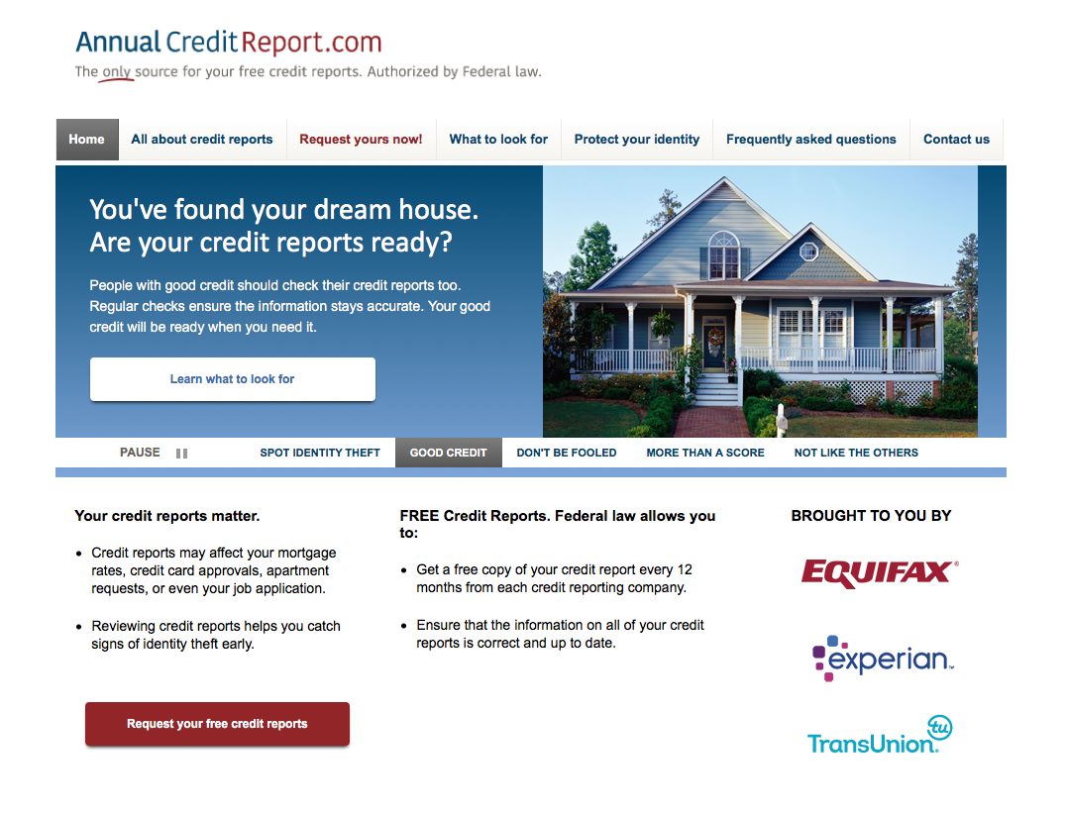
ONLY
https://www.annualcreditreport.com
SITE

Slide 24
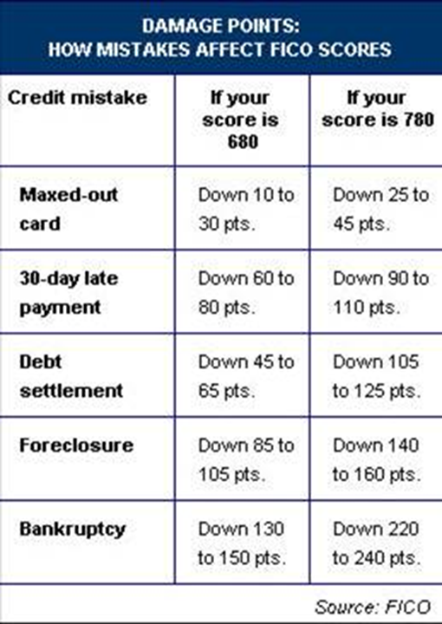
DAMAGE POINTS (FICO)
Credit Mistake | If score is 680 | If score is 780
Maxed out card | Down 10 to 30 pts. | Down 25 to 45 pts.
30 days late | Down 60 to 80 pts. | Down 90 to 110 pts.
Debt settlement | Down 45 to 65 pts. | Down 105 to 125 pts.
Foreclosure | Down 85 to 105 pts. | Down 140 to 160 pts.
Bankruptcy | Down 130 to 150 pts. | Down 220 to 240 pts.

Slide 25
HOW CAN I IMPROVE MY CREDIT?

Slide 26
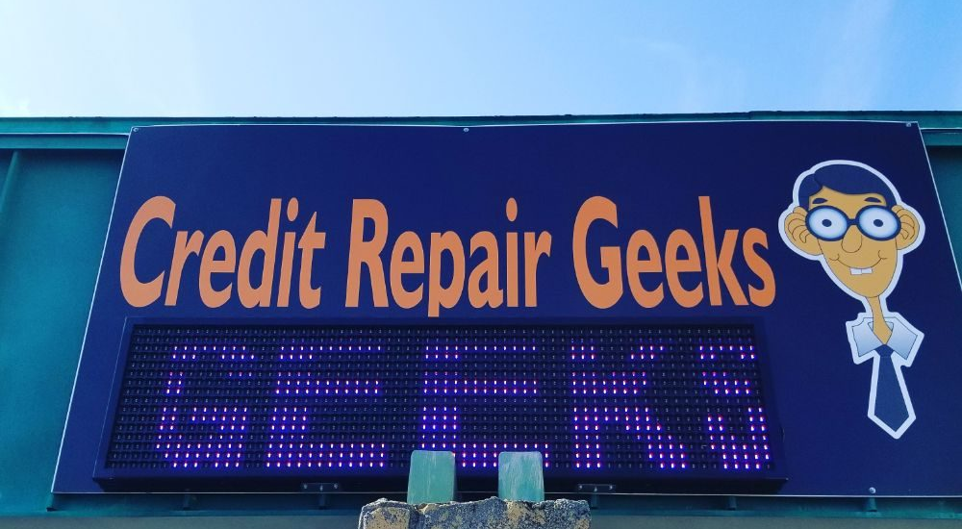

Slide 27
BE A SHREWD BORROWER
A SHREWD checklist of questions to ask
Sincere need or want.
Happy to pay. Will I be glad I bought it when payment time comes.
Room. Is there room in my spending plan for payments?
Extra cost. How much more will charging cost.
Waiting cost. Lose anything by waiting?
Discipline. Will I be disciplined enough to pay this off?

Slide 28
KNOW THE LIMIT: THE 20-10 RULE
Total Debt
Monthly Debt Payments
*This rule does not included mortgage-related debt.

Slide 29
CHECK REPORT FOR ERRORS
1 in 5 credit reports have errors
Checking your report helps identify fraud
Checking your own credit report has no impact on your credit score

Slide 30
PAY BILLS ON TIME
Pay bills on time: late payments can have a significantly negative impact
Missed payments-- get current and stay current
Paying off a collection account will not remove it. Will remain for 7 years
Having trouble making ends meet---contact creditors or see a credit counselor

Slide 31
REDUCE DEBT OWED
Keep balances low on credit cards and other revolving debt
Pay off debt rather than moving it around

Slide 32
Ann A. Berry, PhD, MBA, RFG®
Professor, Consumer Economics
Jane A. Gault, MS
UT Extension, Retired
Cristopher Miramontes
UT Extension, Communications Coordinator I
© UT Extension – FCS, 2025

